Slide 1



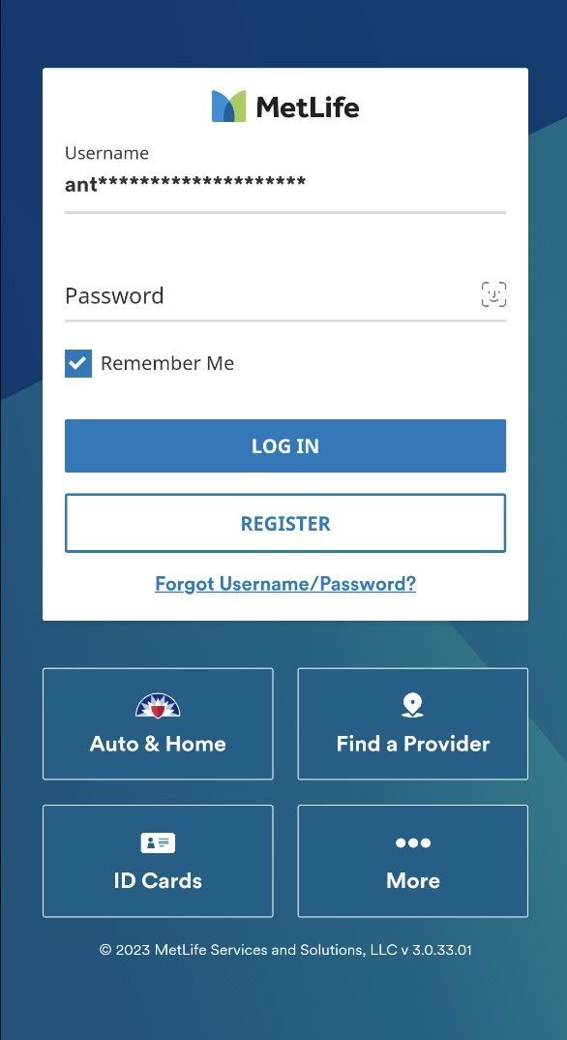




MetLife US Mobile App
Checking your benefits just got easier
MetLife’s mobile app puts convenience in the palm of your hands. You can quickly access and manage your benefit information — anytime, anywhere.
Dental Insurance
Find a dentist
PPO Plans Only: Plan based cost estimator for dental procedures
PPO Plans Only: View your Plan Summary
PPO Plans Only: View your claims
PPO Plans Only: Book an appointment
PPO Plans Only: Provider reviews and ratings
PPO Plans Only: Provider reviews and ratings
View and save ID card
Disability Insurance
View and update claim information
Set up direct deposit for benefit payments
It is easy to get the MetLife US Mobile app
Search “MetLife” in the App Store® or Google Play® and download the MetLife US Mobile App,or scan these QR codes.
Need Technical Assistance? Contact Web Tech. 1-877-9MetWeb 1-877-963-8932
Hours of Operation: Mon-Fri, 8am - 11pm ET/7am - 10pm CT 6am - 9pm MT/5am - 8pm PT
To use the MetLife mobile app, employees can choose to register at metlife.com/mybenefits from a computer or directly through the app. Certain features of the MetLife Mobile App are not available for all MetLife Dental Plans.
Like most group benefit plans, benefit plans offered by MetLife and its affiliates contain certain exclusions, exceptions, waiting periods, reductions, limitations, and terms for keeping them in force. Please contact MetLife or your plan administrator for complete details.

